Slide 1
Static Routing

Slide 2
Static Routing Concept
We need to manually add routing information to the routers
Routers do not automatically create/update routing information
Easy but not efficient
Can be used for small networks

Slide 3
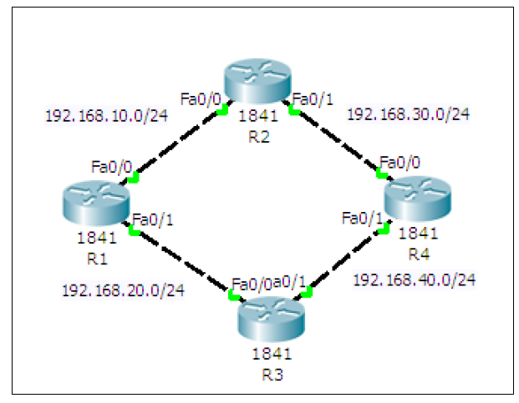
Static Routing Setup
Create a ring topology
(Next slide for details)

Slide 4
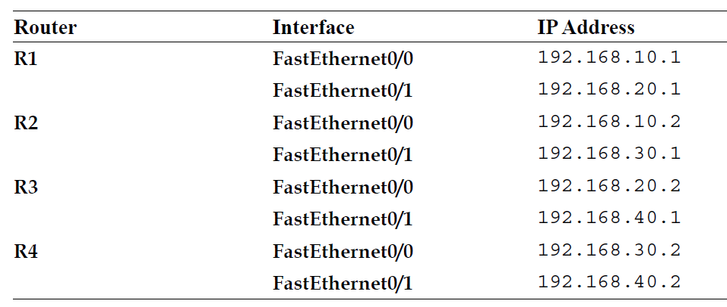
Creating the Ring Topology
Add four routers with the following details – Make sure Port is On

Slide 5
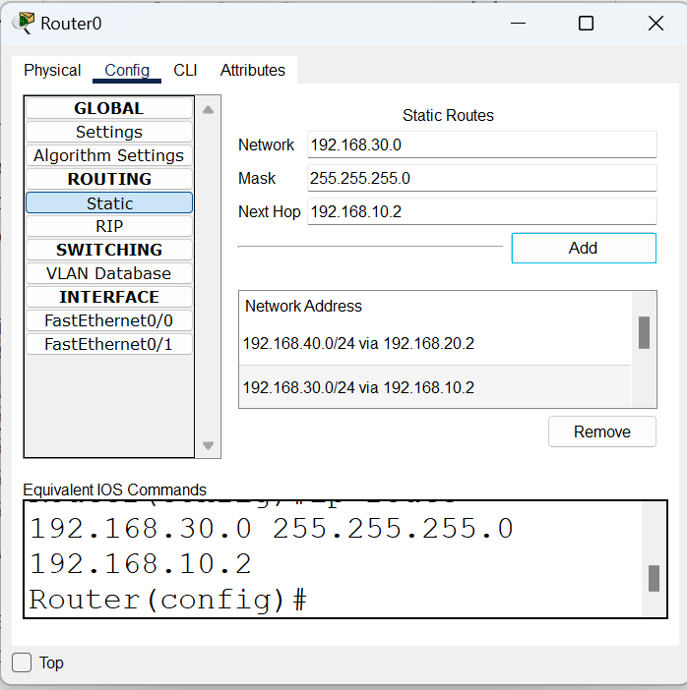
Configuring Routes Statically
Open the first Router (Router 0) and in Routing, add the routes
Enter the details here and click on Add

Slide 6
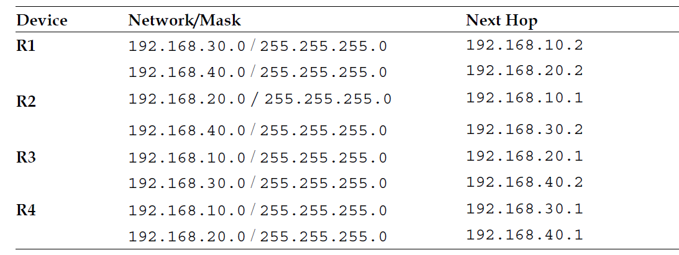
Similarly, for the Others, Add Information as Below

Slide 7
Dynamic Routing

Slide 8
Dynamic Routing
Routing Information Protocol (RIP) is used by routers to exchange information so as to build routing tables
We do not have to add routing information statically now
Routers automatically do this

Slide 9
Configuring RIP
1. Create the same four-router topology we used previously and assign the same IP addresses through the Config tab.

Slide 10
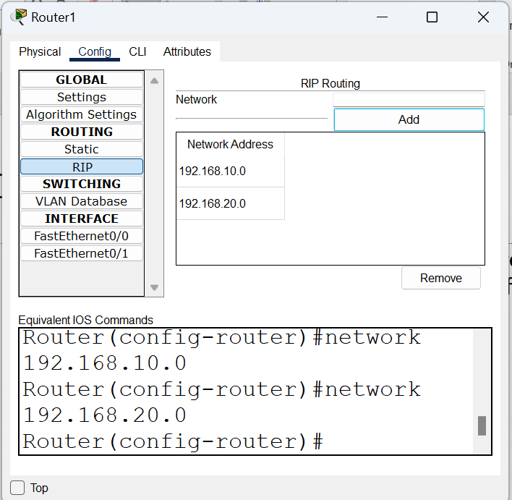
Configuring RIP
2. Click on RIP. This is very easy. Each router now requires only the Network IP of its own interfaces, as shown in the following screenshot:
Full list – next slide

Slide 11
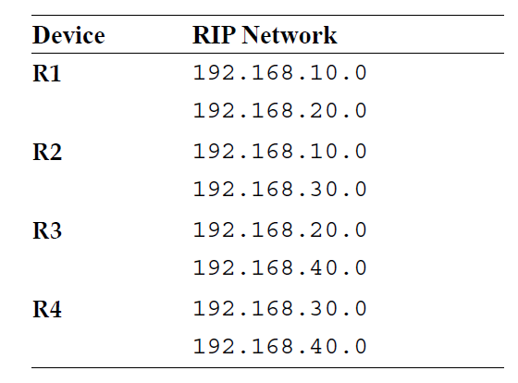
Network Addresses for RIP Configuration

Slide 12
Test using the PDU
Same as before

Slide 13
IGRP/EIGRP

Slide 14
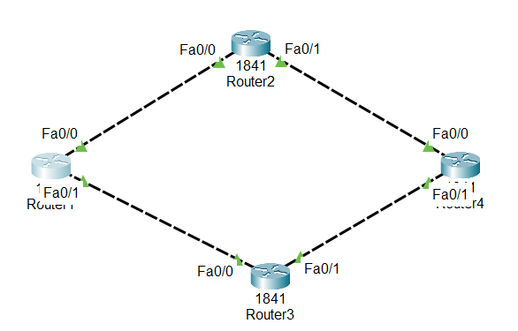
IGRP/EIGRP
Newer versions of Cisco IOS only support EIGRP
We will use the previous configuration, but make sure it has neither static/dynamic (RIP) routing details

Slide 15
IP Addresses

Slide 16
EIGRP on all the Four Routers – Same Commands
Router(config)#router eigrp 1
Router(config-router)#network 192.168.10.0
Router(config-router)#network 192.168.20.0
Router(config-router)#network 192.168.30.0
Router(config-router)#network 192.168.40.0

Slide 17
Test
PDUs
Ping

Slide 18
Open Shortest Path First (OSPF)

Slide 19
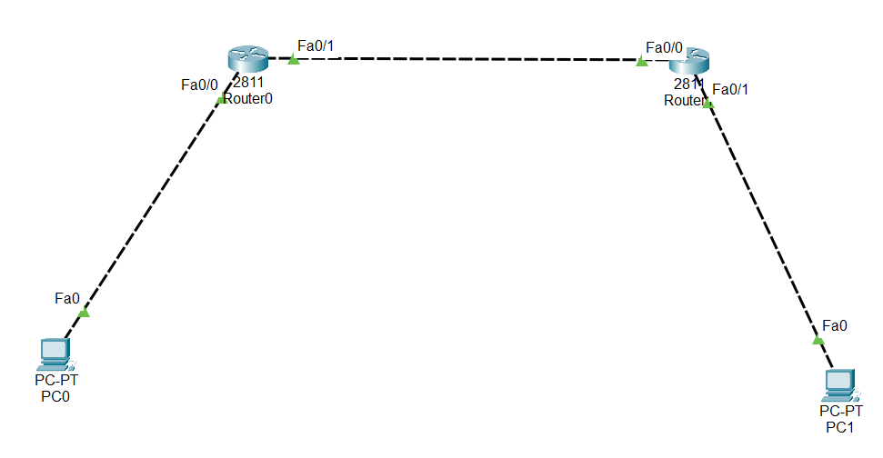
Create the Topology

Slide 20
Configuration
Device | Interface | IP Address
PC0 | - | 10.0.0.2
Router0 | Fa0/0 | 10.0.0.1
 | Fa0/1 | 20.0.0.1
Router1 | Fa0/0 | 20.0.0.2
 | Fa0/1 | 30.0.0.1
PC1 | - | 30.0.0.2

Slide 21
Set Default Gateways
PC | Default Gateway
PC0 | 10.0.0.1
PC1 | 30.0.0.1

Slide 22
Configuring OSPF on the Routers
Area must be the same for all the routers
Router0
Router(config-if)#router ospf 1
Router(config-router)#network 10.0.0.0 0.255.255.255 area 0
Router(config-router)#network 20.0.0.0 0.255.255.255 area 0
Router1
Router(config-if)#router ospf 2
Router(config-router)#network 20.0.0.0 0.255.255.255 area 0
Router(config-router)#network 30.0.0.0 0.255.255.255 area 0
Process id

